Slide 1

6th Grade Accelerated Math
Unit 14, Lesson 7 Solving One-Step Multiplication and Division Equations Algebraically Volume 2, pg. 374

Slide 2


Benchmark
MA.6.AR.2.3
Write and solve one-step equations in one variable within a mathematical or real-world context using multiplication and division, where all terms and solutions are integers.
volume 2, pg. 374

Slide 3
Integrated Mathematical Thinking and Reasoning Standards
MA.K12.MTR.1.1 Actively participate in effortful learning both individually and collectively.
MA.K12.MTR.2.1 Demonstrate understanding by representing problems in multiple ways.
MA.K12.MTR.4.1 Engage in discussions that reflect on the mathematical thinking of self and others.
MA.K12.MTR.5.1 Use patterns and structure to help understand and connect mathematical concepts.
volume 2, pg. 374

Slide 4

Learning Target
Write and solve one-step equations in one variable within a mathematical or real-world context using multiplication and division, where all terms and solutions are integers.
volume 2, pg. 374

Slide 5

Warm-Up
volume 2, pg. 374

Slide 6
14.7.1 Warm-Up: Different Problems, Same Solution
Write four equations whose solutions are all $x=3$.
volume 2, pg. 374

Slide 7

Guided Instruction
volume 2, pg. 375

Slide 8
14.7.2 Guided Instruction: Using Inverses to Solve Equations
Inverse operations are used to solve equations by isolating a variable of interest.
When solving one-step equations using visual models, the inverse operation performed on one side of the model is also performed on the other side to keep the equation balanced.
With your partner, re-visit the meaning of balanced equations. Write a brief summary explaining what it means for equations to be balanced and how balance is maintained when solving. Include examples as part of your summary.
volume 2, pg. 375

Slide 9

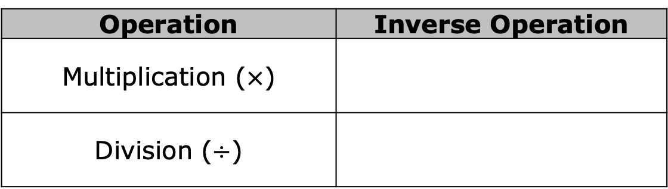
Using the definition of inverse operations, complete the table to indicate which operation would reverse the given operation.
Consider the equation $7m=21$ to complete the following.
Discuss with your partner how to solve $7m=21$.
Operation | Inverse Operation
Multiplication ($×$)
Division ($÷$)
volume 2, pg. 375

Slide 10
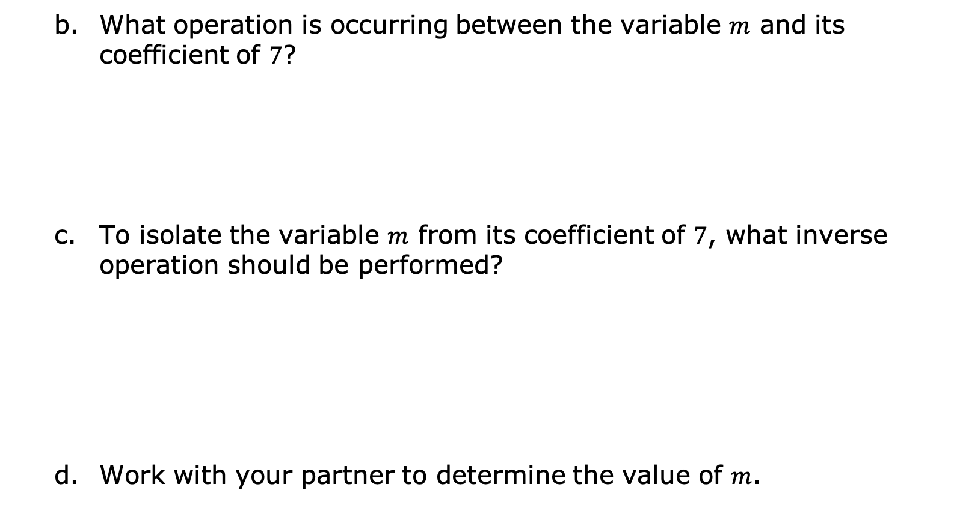
What operation is occurring between the variable $m$ and its coefficient of $7$?
To isolate the variable $m$ from its coefficient of $7$, what inverse operation should be performed?
Work with your partner to determine the value of $m$.
volume 2, pg. 375

Slide 11
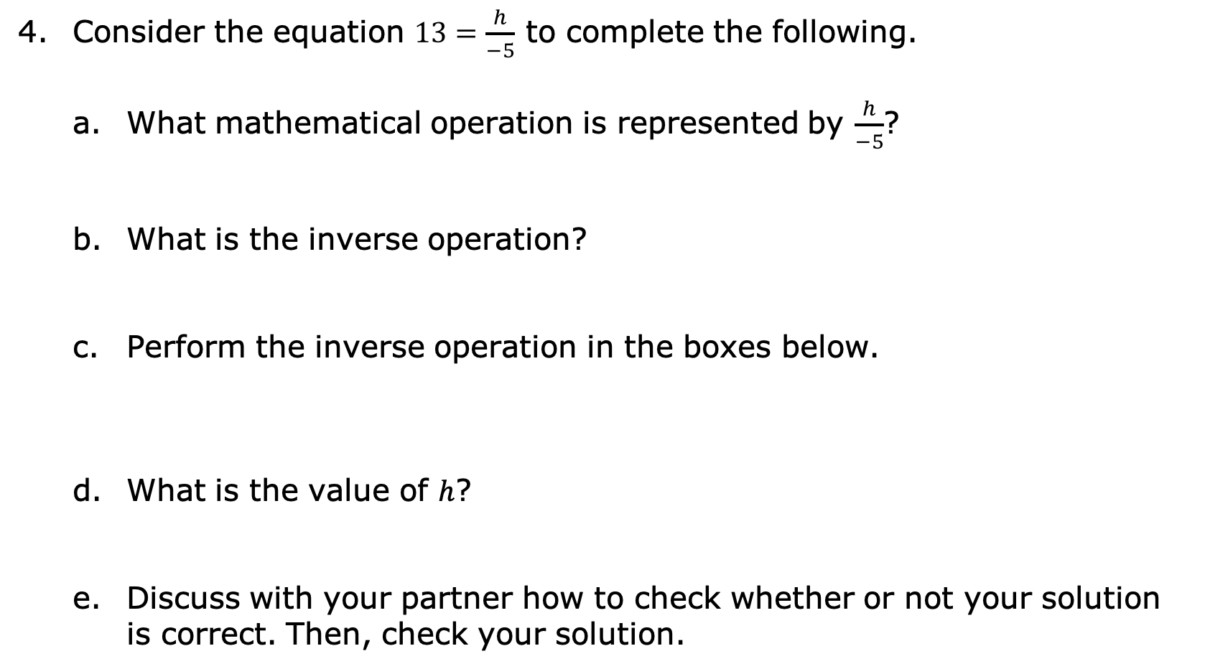
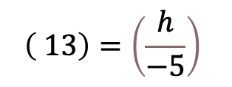
Consider the equation $13=\frac{h}{−5}$ to complete the following.
What mathematical operation is represented by $\frac{h}{−5}$?
What is the inverse operation?
Perform the inverse operation in the boxes below.
What is the value of $h$?
Discuss with your partner how to check whether or not your solution is correct. Then, check your solution.
$$\left( 13\right)=\left(\frac{h}{−5}\right)$$
volume 2, pg. 376

Slide 12

Guided Practice
volume 2, pg. 376

Slide 13

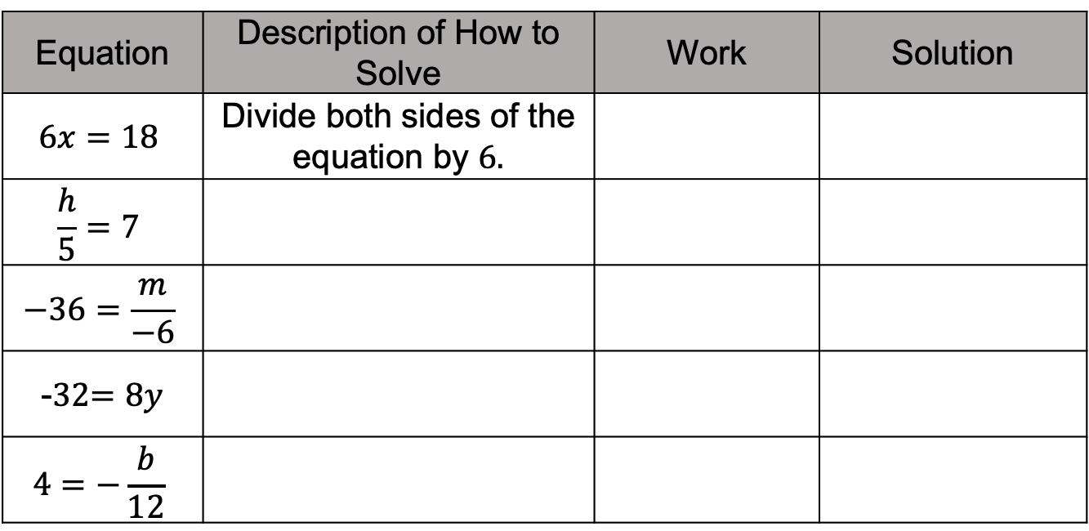
14.7.3 Guided Practice: Solving One-Step Multiplication and Division Equations Algebraically
Complete the table.
Equation | Description of How to Solve | Work | Solution
$$6x=18$$ | Divide both sides of the equation by $6.$
$$\frac{h}{5}=7$$
$$−36=\frac{m}{−6}$$
-32$=8y$
$$4=−\frac{b}{12}$$
volume 2, pg. 376

Slide 14
With your partner, verify each solution is correct using substitution.
volume 2, pg. 377

Slide 15

Your Turn
volume 2, pg. 377

Slide 16
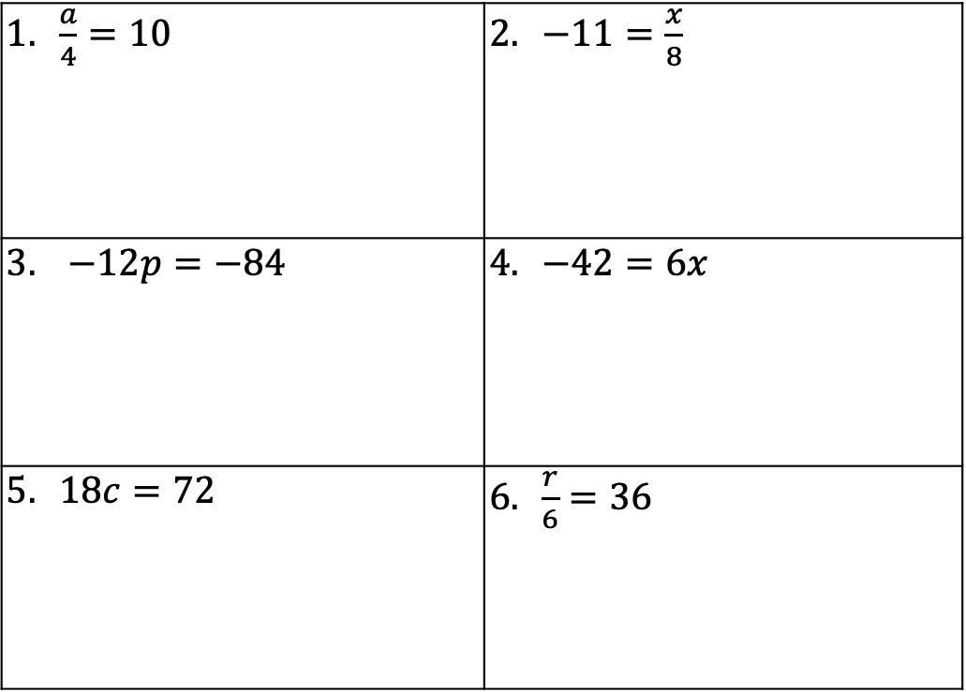
14.7.4 Your Turn!
Solve each equation algebraically. Show your work.
$\frac{a}{4}=10$ | $−11=\frac{x}{8}$
$−12p=−84$ | $−42=6x$
$18c=72$ | $\frac{r}{6}=36$
volume 2, pg. 377

Slide 17

Wrap-Up
volume 2, pg. 378

Slide 18


14.7.5 Wrap-Up: Error Analysis
While checking her homework from last night, Lola noticed she got the following problem incorrect. Examine Lola’s work and write a note to her detailing how she can correct her mistake.
$$42=h÷7$$
$$+7 +7$$
$$49=h$$
volume 2, pg. 378

